Slide 1

Name: M. Vani Batchno: 435
Innomaticsresearchlabs
CUSTOMER CHURN ANALYSIS
PRESENTED BY:
SATISH RAJESH KUMAR RAO

Slide 2

AGENDA
PROBLEM STATEMENT
PROJECT OBJECTIVE
PROJECT OVERVIEW
DATA PREPARATION
DASHBOARD VISUALIZATIONS
KEY INSIGHTS & FINDINGS
APPLICATIONS & RECOMMENDATIONS
CHALLENGES FACED
CONCLUSION

Slide 3
PROBLEM STATEMENT
The telecom company is experiencing increasing customer churn, which is impacting revenue, customer lifetime value, and overall business growth. Although large amounts of customer data are available, the company lacks clear insights into the reasons behind churn and is unable to identify customers who are most likely to leave. This project focuses on identifying the main drivers of churn and detecting high-risk customers using Power BI dashboards. The insights generated will help the company make informed decisions, improve retention strategies, and reduce customer churn.
To address this challenge, a data-driven approach is needed to analyze customer behaviour, service usage, and demographic patterns. Key factors such as contract type, monthly charges, internet services, and customer support play an important role in influencing churn.

Slide 4
PROJECT OBJECTIVE
To analyze customer churn data and identify the key factors driving customer churn.
Analyze customer churn data to identify key factors driving churn.
Identify high-risk customer segments likely to churn.
Evaluate the impact of demographics, service usage, contract types, and billing methods.
Generate actionable insights to support customer retention strategies.

Slide 5
PROJECT OVERVIEW
The project uses the Telco Customer Churn Dataset provided by a telecom company.
It includes key information such as: • Customer demographics – gender, senior citizen status, partner, and dependents • Account details – tenure, contract type, payment method, and paperless billing • Services used – internet, phone, streaming TV, tech support, and security services • Billing data – monthly charges and total charges
The target variable is Churn, which indicates whether a customer has left the service (Yes/No).
Interactive Power BI dashboards were created to visualize churn rate, tenure patterns, service subscriptions, and billing insights.
The analysis helps businesses identify high-risk customers and design effective retention strategies.

Slide 6
DATA PREPARATION
Imported the dataset into Power BI and performed data cleaning.
Replaced null or blank values in Total Charges with “0”.
Standardized entries by replacing "No internet service" with "No" in service-related columns:
• Online Security
• Online Backup
• Device Protection
• Tech Support
• Streaming TV
• Streaming Movies
Corrected data types for numeric and categorical columns.

Slide 7
Validated the dataset to ensure Customer ID uniqueness and absence of duplicates.
Created Tenure Group to group customers into meaningful segments:
• 0–12 months
• 12–24 months
• 24–48 months
• 48–72 months
These groups help identify which customer segments have the highest churn rates.

Slide 8
DASHBOARD OVERVIEW
The Power BI report consists of four main dashboards:
Customer Demographics Analysis
Service Subscription Analysis
Contract & Billing Insights
Churn Prediction & Key Drivers
Each dashboard includes interactive slicers for contract type, gender, senior citizen status, and internet service.

Slide 9
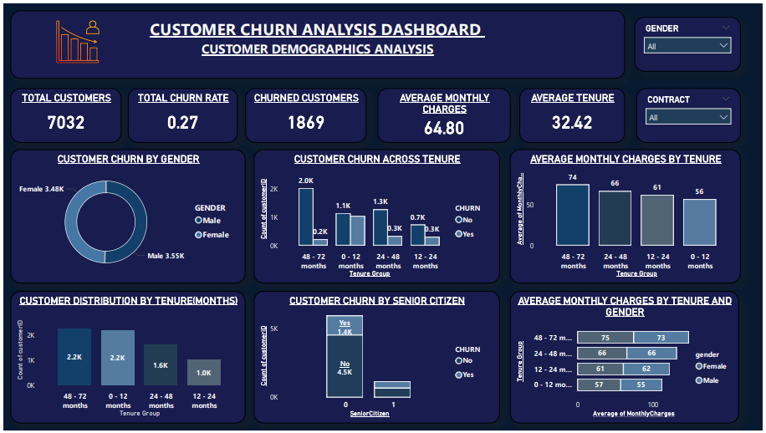

Slide 10
CUSTOMER DEMOGRAPHICS ANALYSIS
KPI Cards:
Total Customers → 7032
Churn Customers → 1869
Churn Rate → 27%
Average Monthly Charge → 64.80
Average Tenure → 32.42
Charts & Visuals:
Donut Chart → Total Customers by Gender
Clustered Column Chart → Average Tenure & Average Monthly Charge by Gender
Bar Chart → Churn Rate by Tenure Group
Line Chart → Average Monthly Charge by Tenure Group
Stacked Column Chart → Total Customers by Senior Citizen and Churn
Column Chart → Total Customers by Tenure Group
Slicers:
Contract
Gender

Slide 11
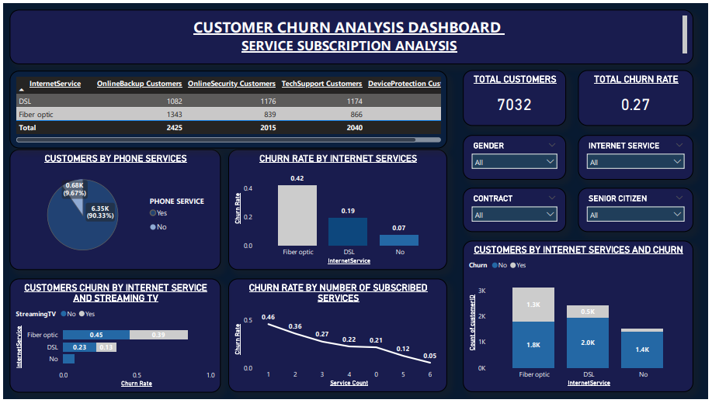

Slide 12
SERVICE SUBSCRIPTION ANALYSIS
KPI Cards:
Total Customers
Churn Rate
Charts & Visuals:
Table Visual → Internet Service vs Add-on Services (Online Security, Backup, Device Protection, Tech Support)
Bar Chart → Churn Rate by Internet Service
Line Chart → Churn Rate by Number of Services
Donut Chart → Total Customers by Phone Service
Stacked Bar Chart → Churn Rate by Internet Service & Streaming TV
Slicers:
Contract
Gender
Senior Citizen
Internet Service

Slide 13
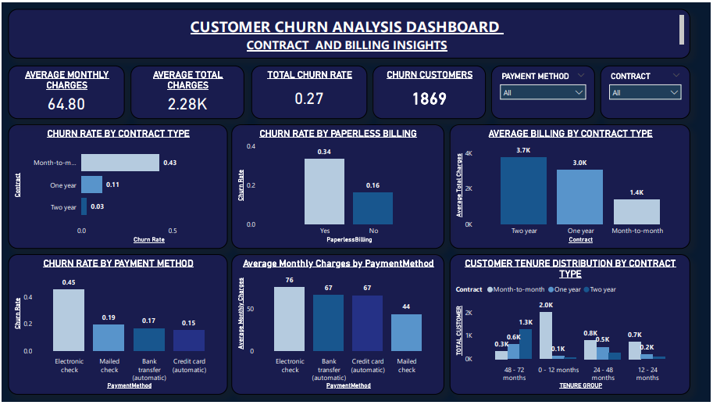

Slide 14
CONTRACT & BILLING INSIGHTS
KPI Cards:
Avg Monthly Charge
Churn Customers
Churn Rate
Average Monthly Charge (billing focus)
Charts & Visuals:
Bar Chart → Churn Rate by Contract
Clustered Column Chart → Total Customers by Tenure Group & Contract
Bar Chart → Churn Rate by Payment Method
Stacked Column Chart → Average Total Charges by Paperless Billing & Churn
Bar Chart → Average Tenure by Contract
Slicers:
Payment Method
Contract

Slide 15
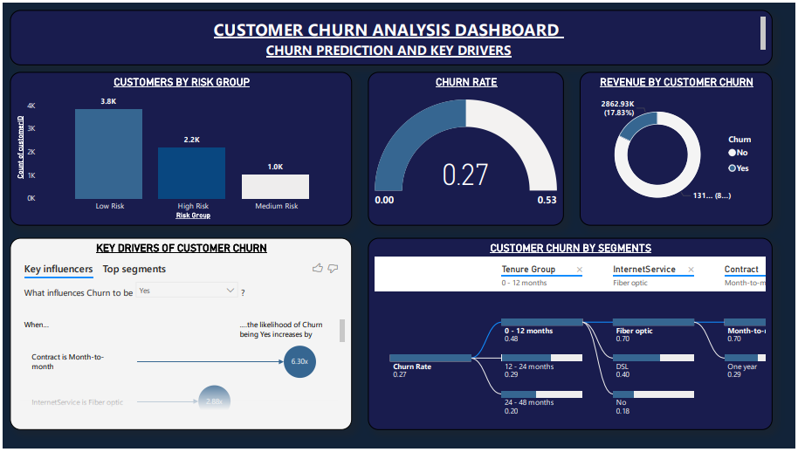

Slide 16
CHURN PREDICTION & KEY DRIVERS
Charts & Visuals:
Column Chart → Total Customers by Risk Score
Gauge Chart → Churn Rate
Donut Chart → Average Total Charges by Churn
Decomposition Tree → Churn by
Contract
Internet Service
Tech Support
Key Influencers Visual → What influences Churn = Yes

Slide 17
KEY INSIGHTS & FINDINGS
Customers on month-to-month plans are more likely to leave compared to those on yearly contracts.
People paying higher monthly fees tend to cancel services more often.
Users with fiber optic internet have a higher chance of leaving than those using DSL.
Customers who don’t have services like Online Security, Tech Support, or Device Protection are more likely to churn.
New customers (0–12 months) leave more frequently, indicating early dissatisfaction.
Senior citizens have a higher tendency to churn than younger customers.
Customers who pay using Electronic Check show the highest churn rate.
Long-term customers (24+ months) and those with yearly plans are more loyal and less likely to leave.

Slide 18
APPLICATIONS & RECOMMENDATIONS
Applications
The dashboard helps track churn patterns and understand customer behaviour clearly.
It enables managers to identify high-risk customers at an early stage.
Teams can analyze which services (like Tech Support or Security) influence customer churn.
Supports data-driven decision-making and helps monitor overall business performance.
Recommendations
Encourage customers to choose long-term contracts (1–2 years) to reduce churn.
Promote add-on services like Tech Support, Online Security, and Device Protection.
Provide better support and engagement for senior citizens and high-paying customers.
Encourage customers to switch to automatic or stable payment methods instead of Electronic Check.

Slide 19
Challenges Faced During the Project
➢ Data Quality Issues The dataset had missing and inconsistent values (especially in Total Charges and service-related fields), so proper cleaning and transformation were needed.
➢ Understanding Business Logic Analyzing churn from a business point of view (like tenure, contracts, and services) was not easy and required domain knowledge beyond technical skills.
➢ Choosing the Right Visuals Selecting visuals that clearly showed insights without making the dashboard crowded took several revisions and testing.
➢ Finding Key Churn Factors Since churn is influenced by multiple factors, it was difficult to identify the main drivers without using advanced visuals like Key Influencers and Decomposition Tree.

Slide 20
CONCLUSION
The overall churn rate is 27%, with the highest churn among month-to-month customers.
Major churn drivers include high monthly charges, fiber optic services, and lack of support features.
Customers with shorter tenure are more likely to leave, while long-term and bundled-service users are more loyal.
The analysis highlights the strong impact of churn on revenue and business performance.
Power BI dashboards provide clear insights into customer behaviour and churn patterns.
The project helps businesses make data-driven decisions and build effective retention strategies.

Slide 21


Slide 22

THANK
YOU

